Slide 1

New York City short-term rental insights

Slide 2
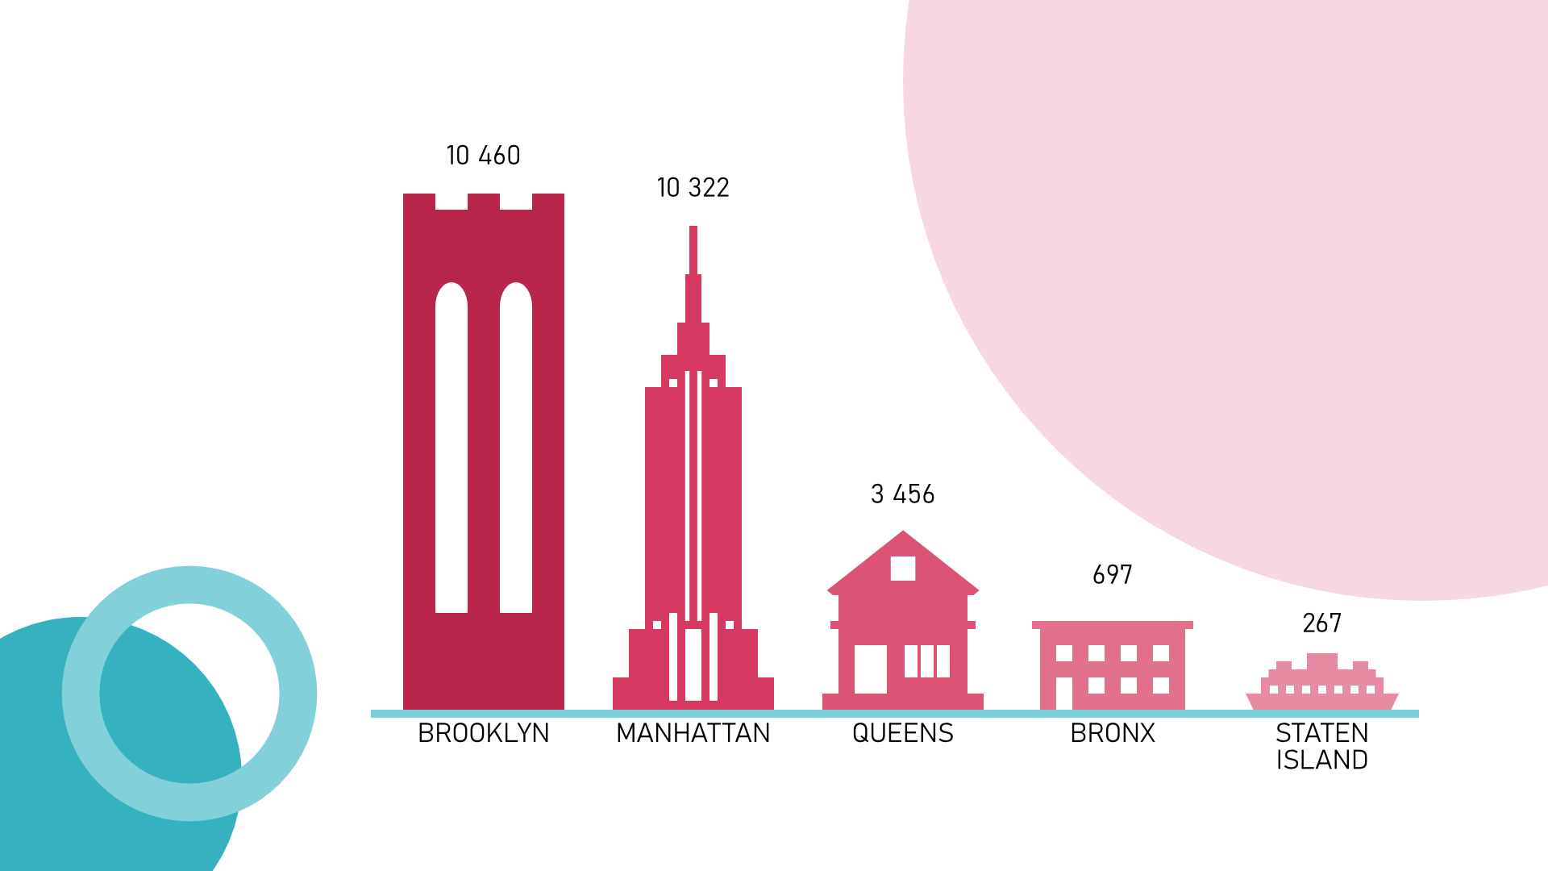
Most popular neighborhood in New York
As you can see, most popular neighborhood in New York city is Brooklyn, then, with almost the same result goes Manhattan, Queens with notable drop in popularity have the middle place, and last places Bronx and Staten Island with 3-digit values.

Slide 3
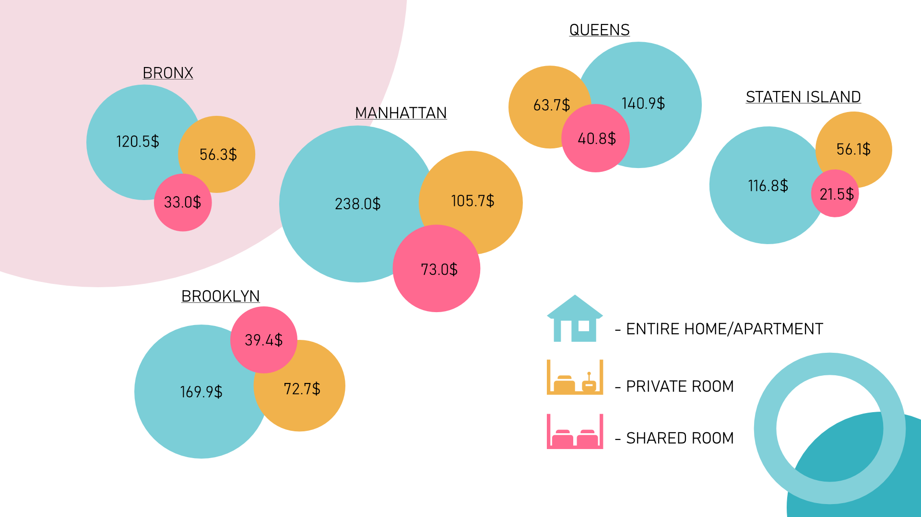
Average rental price for short-term rentals

Slide 4
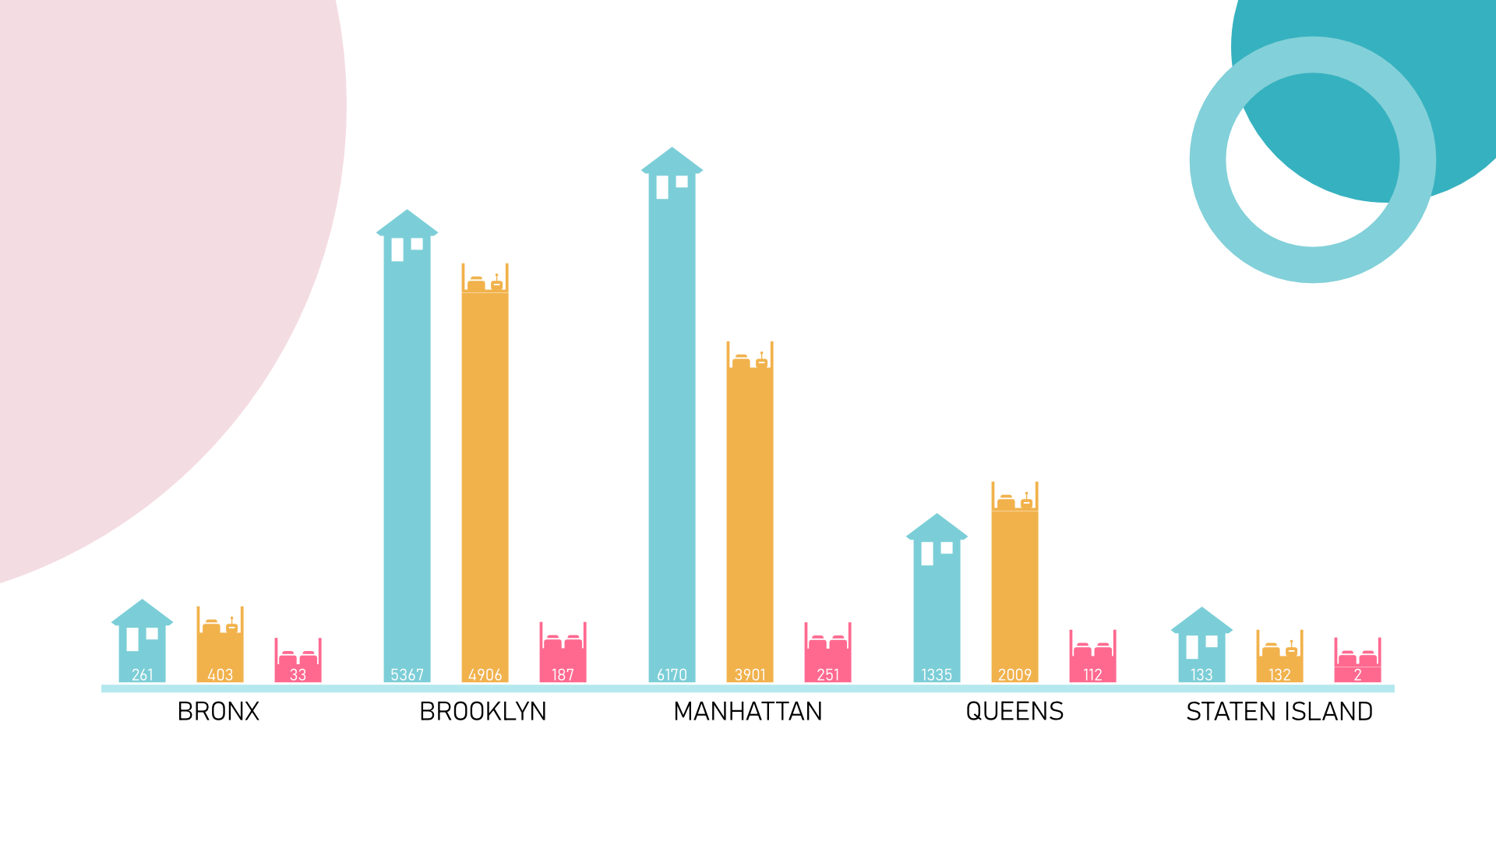
In New York most commonly rented were entire houses or apartments, and least rented were shared rooms with private room in the middle.
But through out of districts this changes for example in Queens and Bronx private rooms were more popular with entire houses on the second place, and in Staten island values for shared rooms and for entire house are almost identical.
Most commonly rented property type

Slide 5
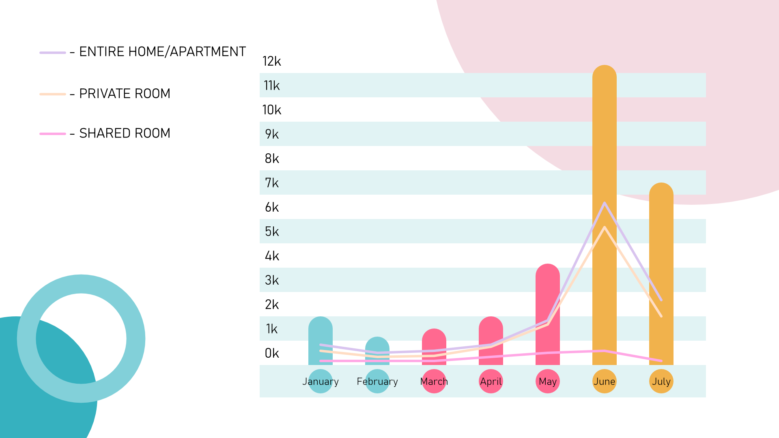
Demand for short-term rentals in New York City over time
As you can see the peak of demand is in the summer, specifically in June, and the lowest demand in February, seasonal trends for room types are coming in similar path, with different number of rents, most popular is entire house and the least is shared rooms like in previous graphs.

